Slide 1
Technical Session 1
Python Lessons 1-2
Design of Computer Programs

Slide 2
Lesson 1: Preparing Development environment
Introducing Python
Installing python
Installing visual studio code

Slide 3
Lesson 2: Python
In this lesson, you will be learning a number of techniques to
Variables
Assignment Operator

Slide 4
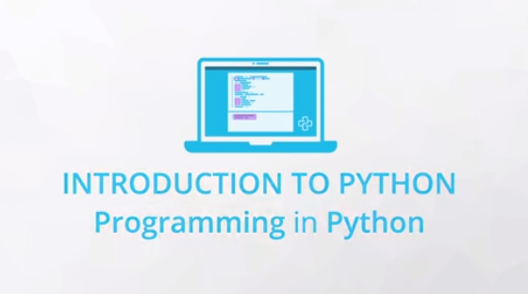
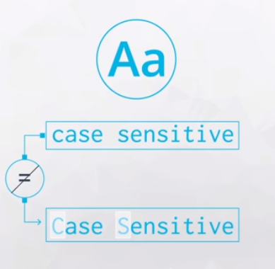
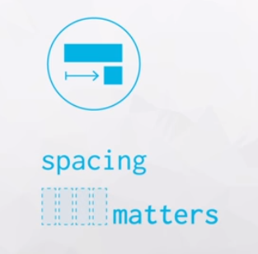
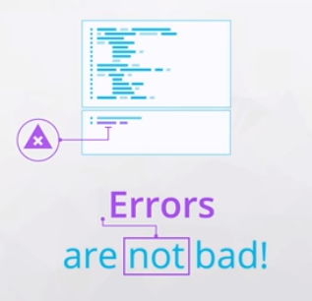

Slide 5

Arithmetic Operators
+ Addition
- Subtraction
* Multiplication
/ Division
% Mod (the remainder after dividing)
** Exponentiation (note that ^ does not do this operation, as you might have seen in other languages)
// Divides and rounds down to the nearest integer

Slide 6
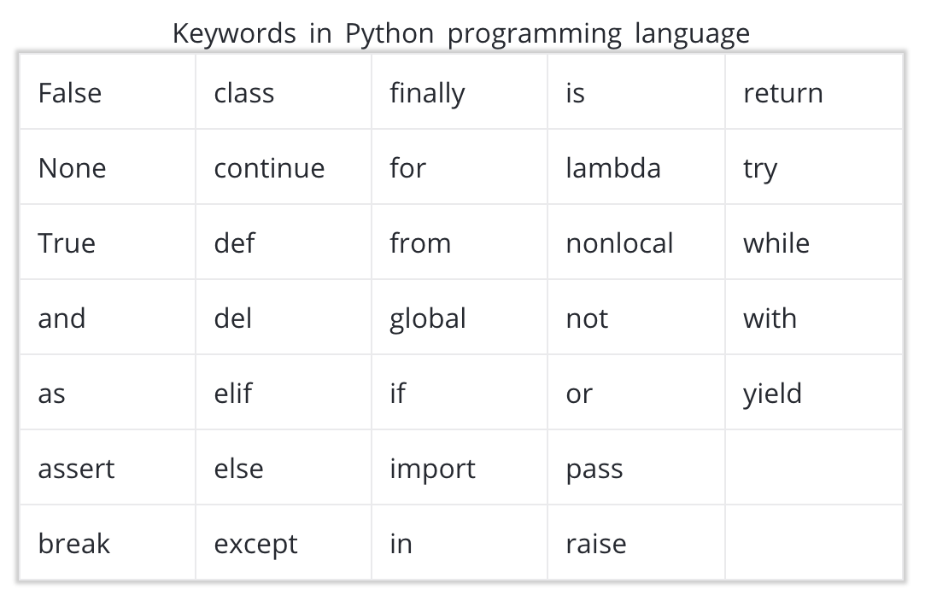
Variables
mv_population = 74728
x = 3
y = 4
z = 5
and
x, y, z = 3, 4, 5
Only use ordinary letters, numbers and underscores in your variable names. They can’t have spaces, and need to start with a letter or underscore.
You can’t use reserved words or built-in identifiers

Slide 7
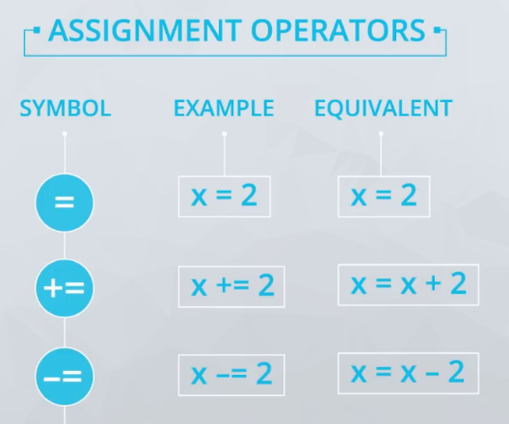
Assignment Operators
>>> carrots = 24
>>> rabbits = 8
>>> crs_per_rab = carrots/rabbits
>>> rabbits = 12
>>> print(crs_per_rab)

Slide 8
Integers and Floats
int - for integer values
float - for decimal or floating point values
You can create a value that follows the data type by using the following syntax:
x = int(4.7) # x is now an integer 4
y = float(4) # y is now a float of 4.0
You can check the type by using the type function:
>>> print(type(x))int
>>> print(type(y))float
Because the float, or approximation, for 0.1 is actually slightly more than 0.1, when we add several of them together we can see the difference between the mathematically correct answer and the one that Python creates.
>>> print(.1 + .1 + .1 == .3) False

Slide 9
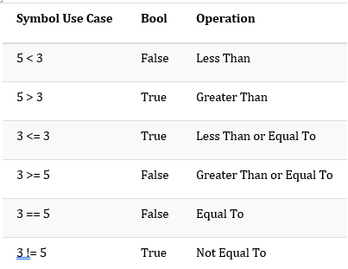
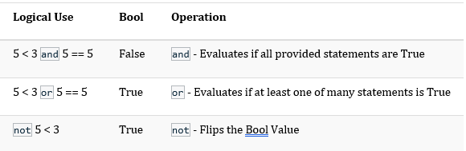
Booleans, Comparison Operators, and Logical Operators
The bool data type holds one of the values True or False, which are often encoded as 1 or 0, respectively

Slide 10
Strings
Strings in Python are shown as the variable type str. You can define a string with either double quotes " or single quotes '. If the string you are creating actually has one of these two values in it, then you need to be careful to assure your code doesn't give an error.
>>> my_string = 'this is a string!’
>>> my_string2 = "this is also a string!!!"
You can also include a \ in your string to be able to include one of these quotes:
>>> this_string = 'Simon\'s skateboard is in the garage.’
>>> print(this_string)Simon's skateboard is in the garage.
If we don't use this, notice we get the following error:
>>> this_string = 'Simon's skateboard is in the garage.’
File "<ipython-input-20-e80562c2a290>", line 1
this_string = 'Simon's skateboard is in the garage.'
SyntaxError: invalid syntax

Slide 11
Strings
>>> first_word = 'Hello’
>>> second_word = 'There’
>>> print(first_word + second_word)
HelloThere
>>> print(first_word + ' ' + second_word)
Hello There
>>> print(first_word * 5)
HelloHelloHelloHelloHello
>>> print(len(first_word))
5
>>> first_word[0]
H

Slide 12
Type And Type Conversion
You have seen four data types so far:
int
float
bool
string
You got a quick look at type() from an earlier video, and it can be used to check the data type of any variable you are working with.
>>> print(type(4)) int >>> print(type(3.7)) float >>> print(type('this’)) str >>> print(type(True)) bool
You saw that you can change variable types to perform different operations. For example,
"0" + "5"
provides completely different output than
0 + 5
What do you think the below would provide?
"0" + 5
How about the code here:
0 + "5"

Slide 13
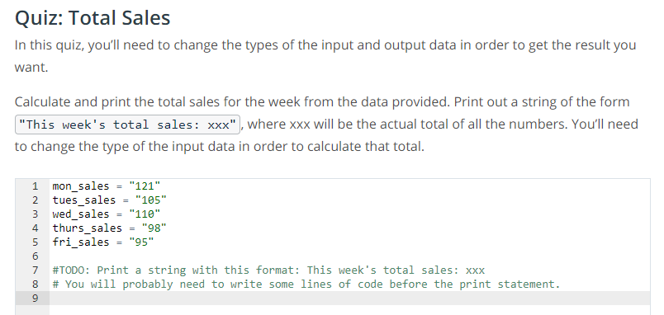
Quiz

Slide 14
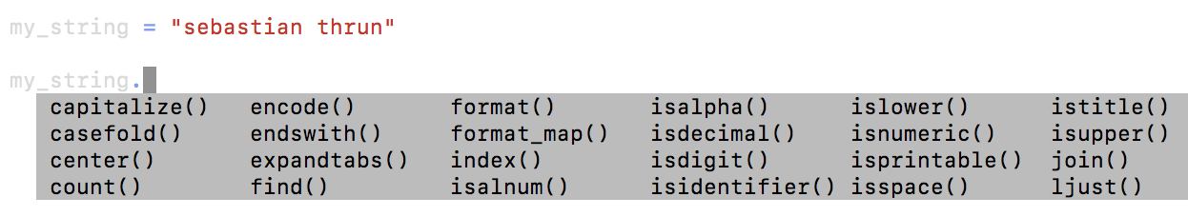
String Methods
>>> my_string.islower() True >>> my_string.count('a’) 2 >>> my_string.find('a’) 3
Example 1
print("Mohammed has {} balloons".format(27))
Example 1 Output
Mohammed has 27 balloons
Example 2
animal = "dog“
action = "bite“
print("Does your {} {}?".format(animal, action))
Example 2 Output
Does your dog bite?
Example 3
maria_string = "Maria loves {} and {}“
print(maria_string.format("math", "statistics"))
Example 3 Output
Maria loves math and statistics

Slide 15
String Method - split
A basic split method:
new_str = "The cow jumped over the moon."new_str.split()
Output is:
['The', 'cow', 'jumped', 'over', 'the', 'moon.']
Here the separator is space, and the maxsplit argument is set to 3.
new_str.split(' ', 3)
Output is:
['The', 'cow', 'jumped', 'over the moon.']
Using '.' or period as a separator.
new_str.split('.')
Output is:
['The cow jumped over the moon', '']
Using no separators but having a maxsplit argument of 3.
new_str.split(None, 3)
Output is:
['The', 'cow', 'jumped', 'over the moon.']

Slide 16

Debugging
Understanding Common Error Messages
"ZeroDivisionError: division by zero.".
"SyntaxError: unexpected EOF while parsing"
greeting = "hello"print(greeting.upper
"TypeError: len() takes exactly one argument (0 given)". This message tells me how many arguments the function requires (one in this case), compared with how many I gave it (0). I meant to use len(chars) to count the number of characters in this long word, but I forgot the argument.
chars = "supercalifragilisticexpialidocious“
len()

Slide 17
Thank You

